Slide 1
Product Teardown:
Assembling the Community
By: Saransh Jindal

Slide 2


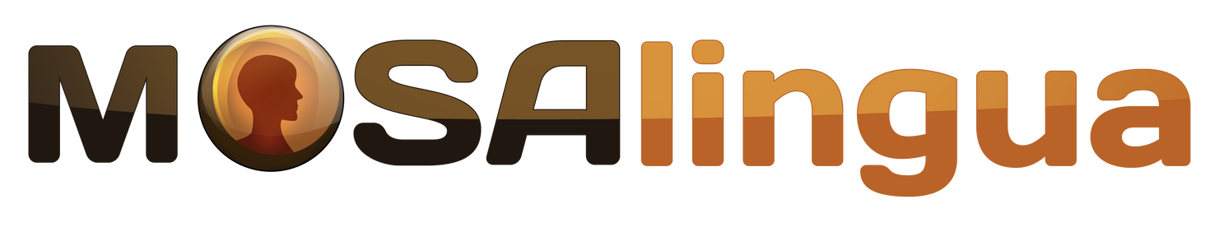
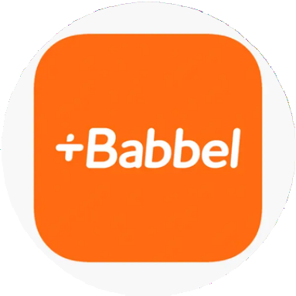
Overview
Competitors
Duolingo provides a gamified language learning experience to learn 40+ languages according to user needs. It provides a freemium model and uses interactive lessons, quizzes and stories to engage users and adapt to their learning styles. It uses adaptive algorithms to personalize their learning experience.

Slide 3
Key Statistics
More than 2 Billion people are studying a foreign language worldwide.
Total Duolingo users = 575 Million Monthly Active Users = 56 Million Daily Active Users = 19 Million
Number of premium Users = 5.2 Million Average visit duration per user = 20:17 minutes
“#1 Top Free in Education”
~Play Store
“#2 in Education”
~App Store
4.4 Rating on Play Store with
18M reviews.
4.7 Rating on App Store with 2.2M reviews

Slide 4


User Persona
Name: Radhika Tripathi
About: B.Tech Student
Age: 21 Years
Goals:
Wishes to move to Germany for Masters. Wants to learn German.
Pain Points:
No good resource to learn German language.
Not willing to spend enough money on
expensive courses/trainer.
Name: Akshay Gupta
About: Consultant
Age: 32 Years
Goals:
Contribute more to his company with international clients.
Wants to learn Spanish.
Pain Points:
Unable to give lot of time for learning. Lacks enough knowledge of Spanish to communicate.

Slide 5
Value Proposition
Users can learn 40+ languages including English, Spanish, Chinese, French, etc. Focuses on User Experience primarily. Classic example of “Play First, Profile Second”.
Fun and engaging notifications daily to remind the user to engage with app daily. Has a free blog educating users with different language tips while giving cult references making fun to read.
Conducts online events and conferences.
Also conducts a Duolingo English Test which many universities(Yale, Duke, Columbia, NYU, Georgia Tech etc.) across the world for testing english proficiency.
Fun fact: Fictional language in Game of Thrones “High Valyrian” can also be learnt at Duolingo

Slide 6
Gamification Unleashed
Steady Progression: Duolingo’s approach to language learning is based on the idea of incremental progress just like in games like Candy Crush.
The Power of Streaks: Duolingo uses loss aversion as a psychological tool to motivate users to login the app daily and complete at least one lesson.
Clever Copying Writing: The team at Duolingo made a conscious effort to create a positive and engaging experience for their users as learning a new language can be challenging. They greet users with cheerful messages like “Let’s do this!” and “Time to get your language on!” even in the loading sequences and notifications.

Slide 7
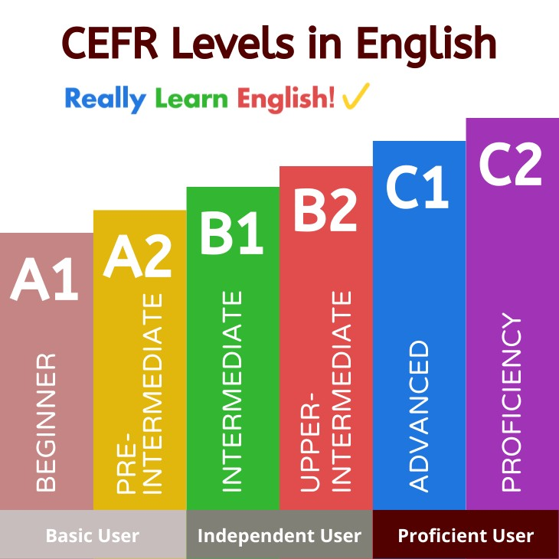
Big Challenge
Duolingo hasn’t been successful in making users learn to even conversational level even after text, speech, and voice recognition features.
According to CEFR levels, maximum B1 level can be attained using Duolingo.
So, people find it hard to do conversations even after learning from Duolingo.

Slide 8
The Solution: Building Community
Proficiency in a language can be brought when real-life conversations happen with hearing and speaking activities.
Duolingo has done a good job of tracking user’s progress, connecting friends, and sharing leaderboards.
Duolingo can build community and conduct one-on-one talk sessions something similar to Omegle where users can be matched randomly according to language preference.
According to Unity’s Multiplayer Report 2022, social factors are prime decision and engagement drivers, hence it can help in increasing user engagement too along with a whole new experience solving a critical problem.

Slide 9
Thank You!!
By: Saransh Jindal

